Slide 1
Voice Automation Smart Billing System
B.Sanjay (221801045) B.Soorya (221801051)

Slide 2
Problem Statement
Traditional billing systems rely on manual data entry, leading to inefficiencies, errors, and delays in transaction processing. These systems can be inconvenient for users and lack accessibility for individuals requiring hands-free interactions. To address these challenges, this research develops a Voice-Activated Smart Billing System that utilizes speech recognition technology to automate the billing process, enhancing transaction speed, accuracy, and user convenience in retail environments.

Slide 3
Abstract
The application uses voice recognition technology to make the billing process faster and easier. Customers can give billing instructions and complete transactions using their voice. The system provides real-time updates on billing details, payments, and invoices, reducing mistakes and saving time. With voice commands, users can control the system hands-free, which is helpful in busy places. This smart solution makes the billing process simple, improves customer experience, and boosts efficiency.

Slide 4
Existing System
Manual Data Entry
Description:
Users enter product details, prices, and customer information manually.
Every transaction requires typing, calculating totals, and applying discounts by hand.
This process is slow and needs constant attention.
Drawbacks:
Time-consuming and slows down the billing process.
Higher chance of errors in data entry and calculations.
Difficult to handle large numbers of customers quickly.

Slide 5
Existing System
Limited Automation
Description:
Most systems rely on users to perform all billing steps manually.
There is little to no automation for calculations or invoice generation.
Users must manually store and manage billing data.
Drawbacks:
Repetitive tasks take extra time and effort.
Lack of automation increases the workload.
Errors can occur when handling large data manually.

Slide 6
Limitation of Existing System
Time-Consuming Process: Manual data entry slows down the billing process, making it inefficient.
High Error Rate: Increased chances of mistakes in data entry and calculations.
Lack of Automation: Users must manually perform calculations, apply discounts, and generate invoices.
Increased Workload: Repetitive tasks require constant attention, leading to fatigue and inefficiency.

Slide 7
Proposed System
Overview: The proposed system is a voice-activated smart billing solution designed to automate the billing process, reduce errors, and improve efficiency. It will allow users to perform billing operations using voice commands, eliminating manual data entry and calculations.
Key Features:
Voice-Activated Input
Automated Billing & Calculations
Quick Checkout Process
Data Analysis & Insights

Slide 8
Benifits of Proposed System
Faster Billing Process: Reduces time spent on data entry and calculations.
Minimized Errors: Automated calculations lower the risk of mistakes.
Hands-Free Operation: Enhances convenience and efficiency.
Improved Customer Handling: Enables quick transactions, even during peak hours.
Better Data Management: Ensures secure and organized storage of billing records.
Enhanced Business Insights: Provides analytics for better decision-making.

Slide 9
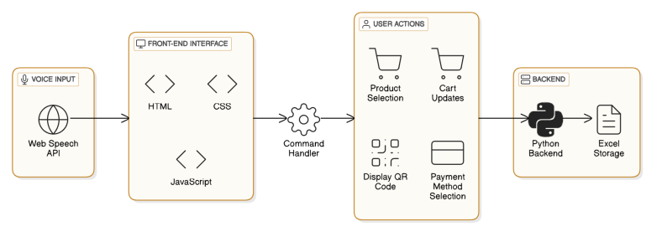
Architecture Diagram

Slide 10
Modules Used
Front-End Interface Module
Components: HTML, CSS, JavaScript
Role:
Manages the user interface
Integrates with the Web Speech API to capture voice commands
Uses a command handler to process voice inputs
Triggers UI updates and initiates user actions based on commands

Slide 11
Modules Used
User Actions Module
Components: Product Selection, Cart Updates, Display QR Code, Payment Method Selection
Role:
Carries out actions from voice commands
Handles steps like selecting products and making payments
Helps users move smoothly through the billing process

Slide 12
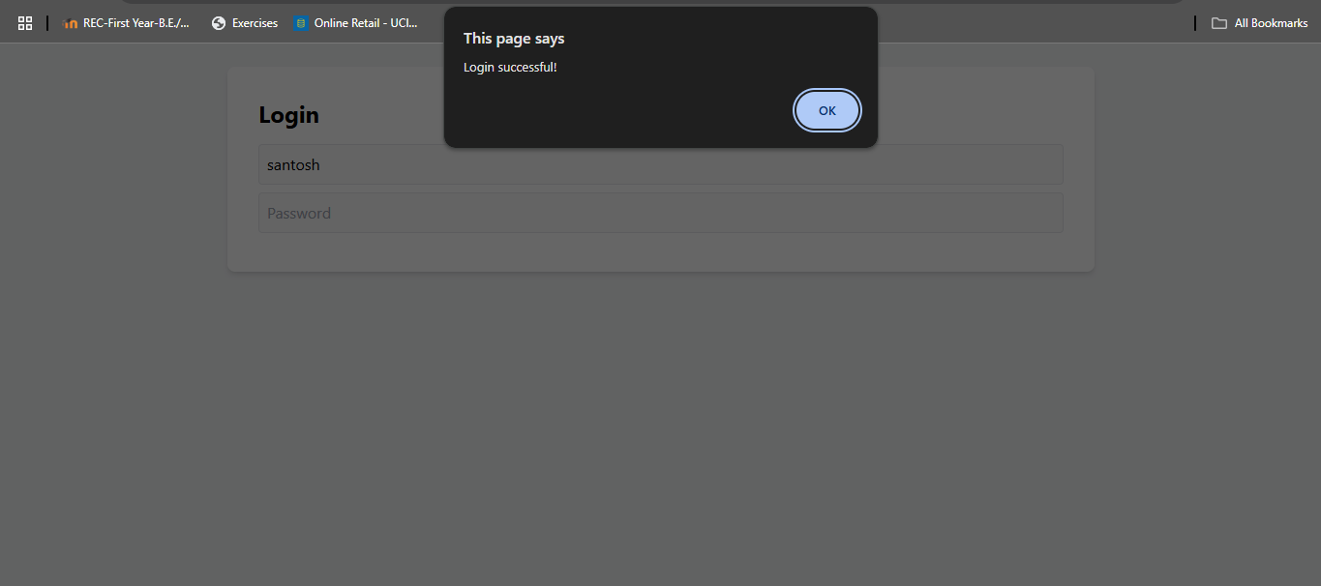
Output Screenshot

Slide 13
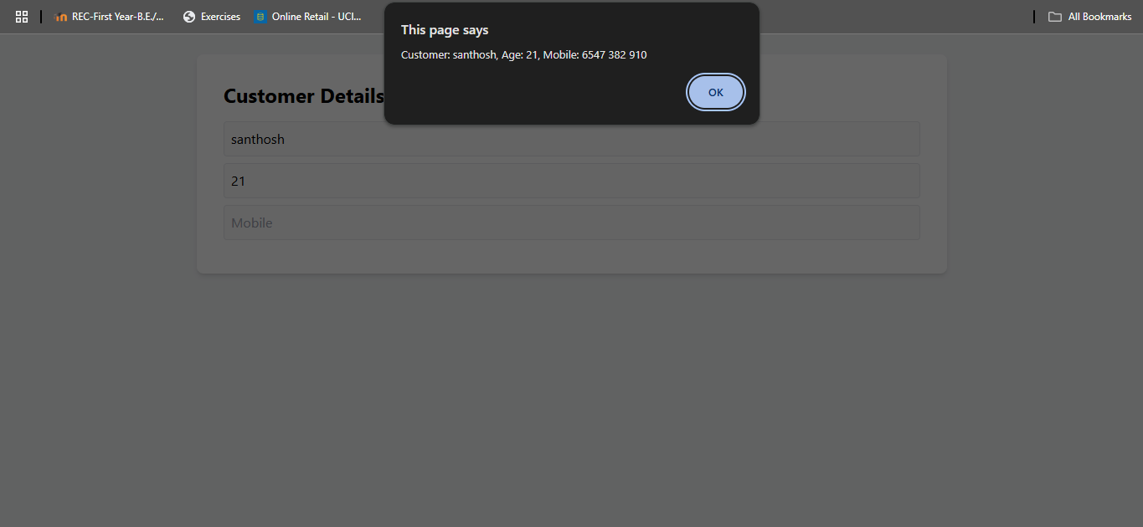
Output Screenshort

Slide 14
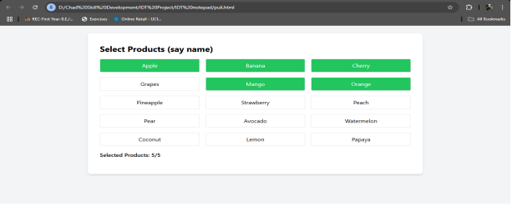
Output Screenshort

Slide 15
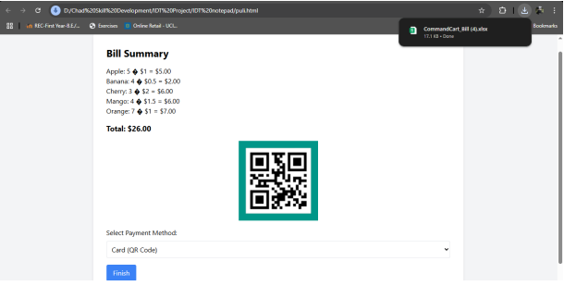
Output Screenshort

Slide 16
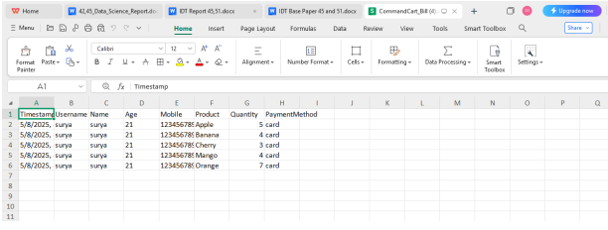
Output Screenshot

Slide 17
Result and Discussion
Result:
The Voice Billing System successfully captures user details, allows voice-based product selection, calculates totals dynamically, and provides a seamless checkout process with payment options.
Discussion:
This system integrates speech recognition for hands-free interaction, enhancing user convenience. It ensures smooth data processing, real-time UI updates, and structured workflow, making it suitable for smart retail environments.

Slide 18
THANK YOU

